Slide 1


Key Market Drivers of Gold Price Movements
INFO 523 FA25 001
Sadaf Moghisi, Abdul Wahed Nab
Instructor: Prof. Yan Han

Slide 2
CONTENT
Price Dynamics
Clustering
Association
Classification
Gold Price Drivers

Slide 3
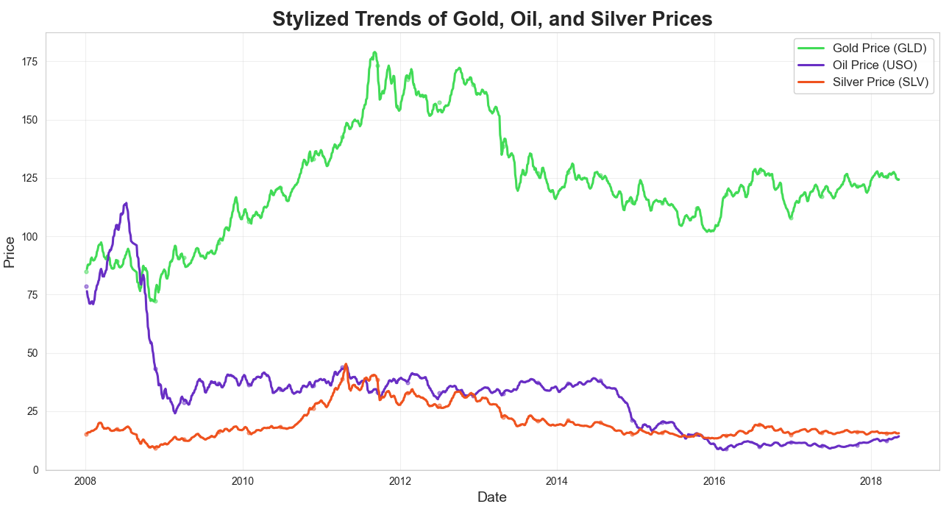
Understanding Gold, Oil, and Silver Price Dynamics
Why Gold Matters in Global Markets
With a multi-trillion-dollar market size, gold remains one of the most influential financial assets worldwide.
Historically serves as a stability anchor during periods of volatility and uncertainty.
Gold’s Function in Modern Finance
Frequently used as a hedge against inflation, currency depreciation, and macroeconomic shocks.
Holds strategic importance in portfolio diversification and central bank asset allocations.
Importance of Forecasting Gold Movements
Helps investors make better timing and allocation decisions.
Supports risk-aware strategies for financial institutions and traders.
Understanding its co-movement with oil (USO) and silver (SLV) provides deeper insights into commodity-market behavior.
Notes:
“This figure shows the stylized price trends of Gold, Oil, and Silver over a ten-year period. Gold has a large global market value—over 13 trillion dollars—and acts as a major safe-haven asset in times of economic stress. Because gold responds to inflation, interest rates, and equity market volatility, it plays an essential role in portfolios and central bank reserves. Understanding and predicting gold price movements is important not only for investors, but also for financial institutions that rely on stable risk management strategies. The relationship between gold and other commodities—particularly oil and silver—is also crucial. That’s why our analysis focuses on uncovering patterns and associations across these markets.”

Slide 4
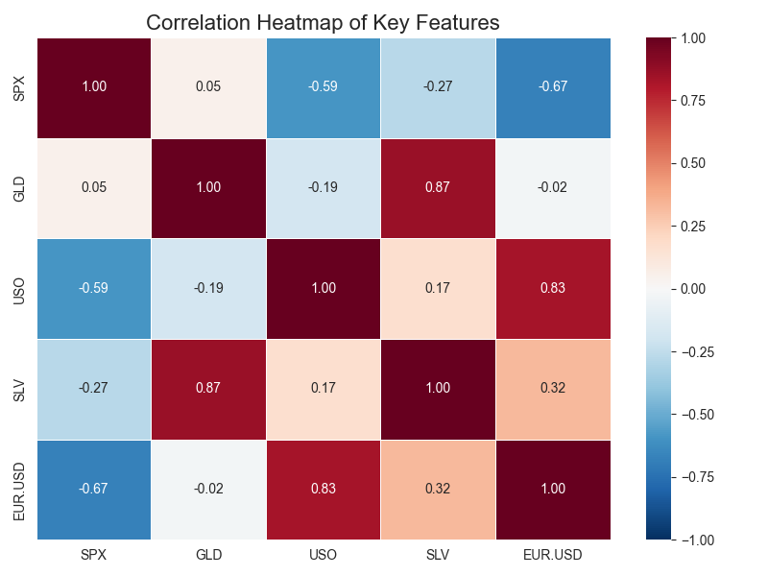
Understanding the Drivers Behind Gold Price Movements
Why Predicting Gold Prices is Challenging
Gold prices respond to a wide network of global forces, making their behavior difficult to model with simple relationships.
They are shaped by economic conditions, market sentiment, currency fluctuations, and geopolitical uncertainty—often interacting in nonlinear ways.
Major Factors Influencing Gold
Based on our dataset and correlation analysis, several financial variables show strong associations:
Silver (SLV) – closely co-moves with gold due to shared demand in precious metals markets
Oil (USO) – linked through inflation expectations and macroeconomic cycles
S&P 500 (SPX) – equity performance affects investor risk appetite
EUR/USD exchange rate – currency strength shifts gold’s relative price globally
Why This Analysis Matters
Gold serves as a key indicator of global financial sentiment
Its fluctuations influence portfolio strategies, hedging decisions, and macroeconomic forecasts
Understanding correlations helps identify which variables may enhance prediction accuracy
Notes:
“This heatmap summarizes how gold interacts with other key financial variables. Gold is strongly correlated with silver, reflecting their close movement within the precious-metals sector. Oil, the stock market, and the EUR/USD exchange rate also show meaningful linkages. These relationships reveal why gold prices behave the way they do and highlight which variables are most relevant for prediction. The challenge comes from the fact that all of these drivers change simultaneously, making gold movements complex and highly interdependent.”

Slide 5
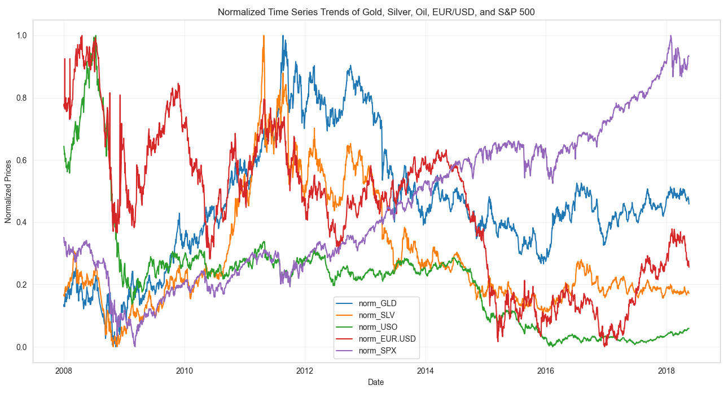
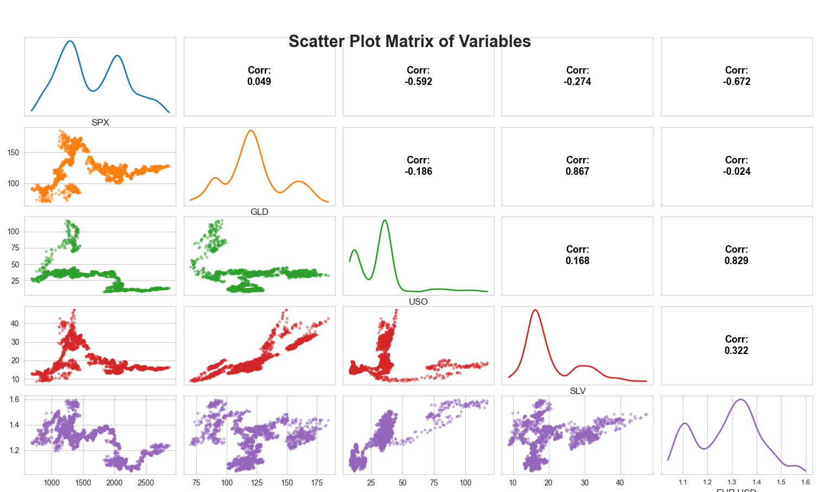
Importance of Key Market Features
Which Market Signals Influence Gold the Most?
Silver (SLV): Moves closely with gold due to shared demand drivers, industrial usage, and investor sentiment. Their strong positive association appears clearly in both the correlation heatmap and scatter-plot matrix.
Oil (USO): Oil shocks affect inflation and global production costs. When inflation expectations rise, gold often strengthens as a protective store of value.
S&P 500 (SPX): Represents overall market performance. Gold frequently behaves as a defensive asset, showing weaker or even negative co-movement with equities during stress periods.
EUR/USD Exchange Rate: Currency fluctuations impact gold because it is priced in USD. A softer dollar generally makes gold cheaper internationally, increasing demand.
Notes:
“On this slide, I highlight the financial variables that provide meaningful information about gold price dynamics. First, silver shows the closest overall alignment with gold, which is visible both in the heatmap and the scatter-plot matrix. This is expected because precious metals often respond similarly to global uncertainty and investment flows.
Oil works differently—it influences gold mainly through inflation expectations. When oil prices rise, production and transportation costs increase, leading investors toward gold as an inflation hedge.
The S&P 500 captures market sentiment. During market downturns, investors often shift from equities into safer assets like gold.
Finally, since gold is denominated in U.S. dollars, the EUR/USD exchange rate matters: a weaker dollar tends to push gold upward.
Together, these features give us a multi-dimensional view of the macroeconomic forces shaping gold behavior.”

Slide 6

Association

Slide 7
Methods
Algorithm | Efficiency | Best for | Strength | Weakness
Apriori | Moderate (Candidate Generation) | Small to Moderate Datasets | Straightforward implementation | Slow for large datasets due to candidate exploration
FP-Growth | High (FP-Tree) | Large Datasets with Dense Patterns | Compact representation and fast for large data | Memory intensive for highly sparse datasets
ECLAT | High (Vertical Format) | Sparse Datasets or Large itemsets | Efficiently handles large itemsets | Limited scalability with very large datasets

Slide 8
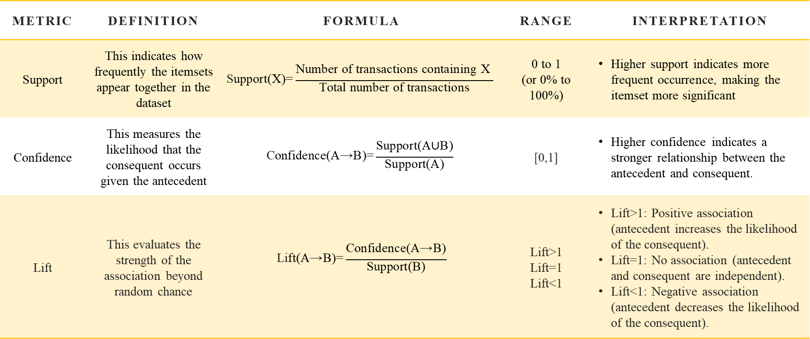
Evaluation
Metric | Definition | Formula | Range | Interpretation
Support | This indicates how frequently the itemsets appear together in the dataset | $$\text{S}\text{upport}\text{(}\text{X}\text{)=}\frac{\text{Number} \text{of} \text{transactions} \text{containing} \text{X}\text{​ }}{\text{Total} \text{number} \text{of} \text{transactions}}$$ | 0 to 1 (or 0% to 100%) | Higher support indicates more frequent occurrence, making the itemset more significant
Confidence | This measures the likelihood that the consequent occurs given the antecedent | $$\text{C}\text{onfidence}\text{(}\text{A}\text{→}\text{B}\text{)=}\frac{\text{Support}\text{(}\text{A}\text{∪}\text{B}\text{)}}{\text{Support}\text{(}\text{A}\text{)}}$$ | [0,1] | Higher confidence indicates a stronger relationship between the antecedent and consequent.
Lift | This evaluates the strength of the association beyond random chance | $$\text{Li}\text{ft}\text{(}\text{A}\text{→}\text{B}\text{)=}\frac{\text{Confidence}\text{(}\text{A}\text{→}\text{B}\text{)}}{\text{Support}\text{(}\text{B}\text{)}}$$ | Lift>1 Lift=1 Lift<1 | Lift>1: Positive association (antecedent increases the likelihood of the consequent). Lift=1: No association (antecedent and consequent are independent). Lift<1: Negative association (antecedent decreases the likelihood of the consequent).

Slide 9
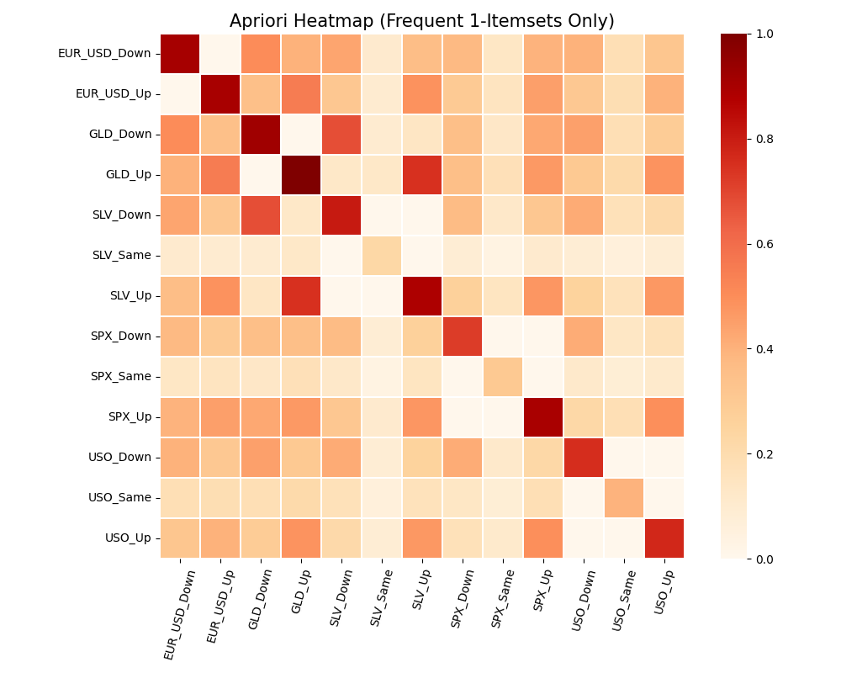
Apriori
Steps:
Generate Candidate Itemsets
Count Support
Iteratively Expand Itemsets
Prune Non-Frequent Itemsets
Repeat generating and pruning
Generate Association Rules
Configuration:
min_confidence=0.7
min_support=0.1
Itemsets:
84 itemsets are identified
Antecedent | Consequent | Support | Confidence | Lift
GLD_Down, SPX_Down, USO_Down | SLV_Down | 0.10 | 0.86 | 2.05
GLD_Down, SPX_Down | SLV_Down | 0.15 | 0.85 | 2.02
GLD_Up, USO_Up, SPX_Up | SLV_Up | 0.13 | 0.86 | 1.86

Slide 10
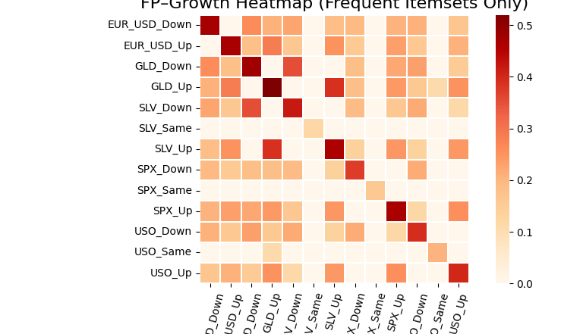
FP-Growth
Steps:
Construct the FP-Tree
Mine the FP-Tree
Generate Frequent Itemsets
Prune Non-Frequent Itemsets
Stop When Tree is Empty
Generate Association Rules
Configuration:
min_confidence=0.7
min_support=0.1
Itemsets:
84 itemsets are identified
Antecedent | Consequent | Support | Confidence | Lift
GLD_Down, SPX_Down, USO_Down | SLV_Down | 0.10 | 0.86 | 2.05
GLD_Down, SPX_Down | SLV_Down | 0.15 | 0.85 | 2.02
EUR_USD_Up, GLD_Up, USO_Up | SLV_Up | 0.1285 | 0.8802 | 1.9036

Slide 11
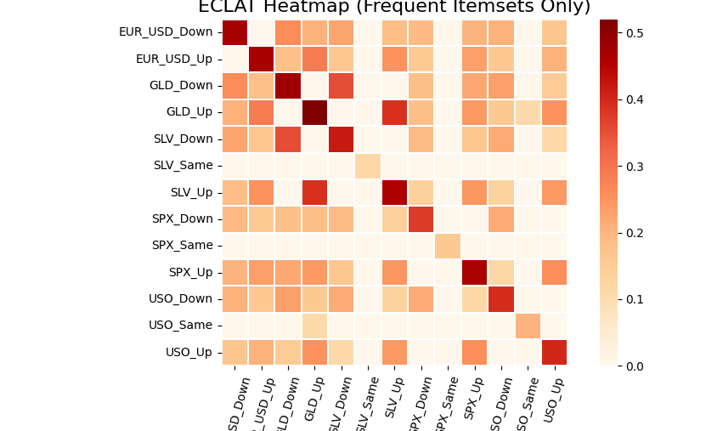
ECLAT
Steps:
Transform Transactions Vertically
Generate Frequent Itemsets
Calculate Support
Prune Non-Frequent Itemsets
Repeat Until Exhausted
Output Frequent Itemsets
Generate Association Rules
Configuration:
min_confidence=0.7
min_support=0.1
Itemsets:
84itemsets are identified
Antecedent | Consequent | Support | Confidence | Lift
GLD_Down, SPX_Down, USO_Down | SLV_Down | 0.10 | 0.86 | 2.05
GLD_Down, SPX_Down | SLV_Down | 0.15 | 0.85 | 2.02
EUR_USD_Up, GLD_Up, USO_Up | SLV_Up | 0.12 | 0.88 | 1.90

Slide 12
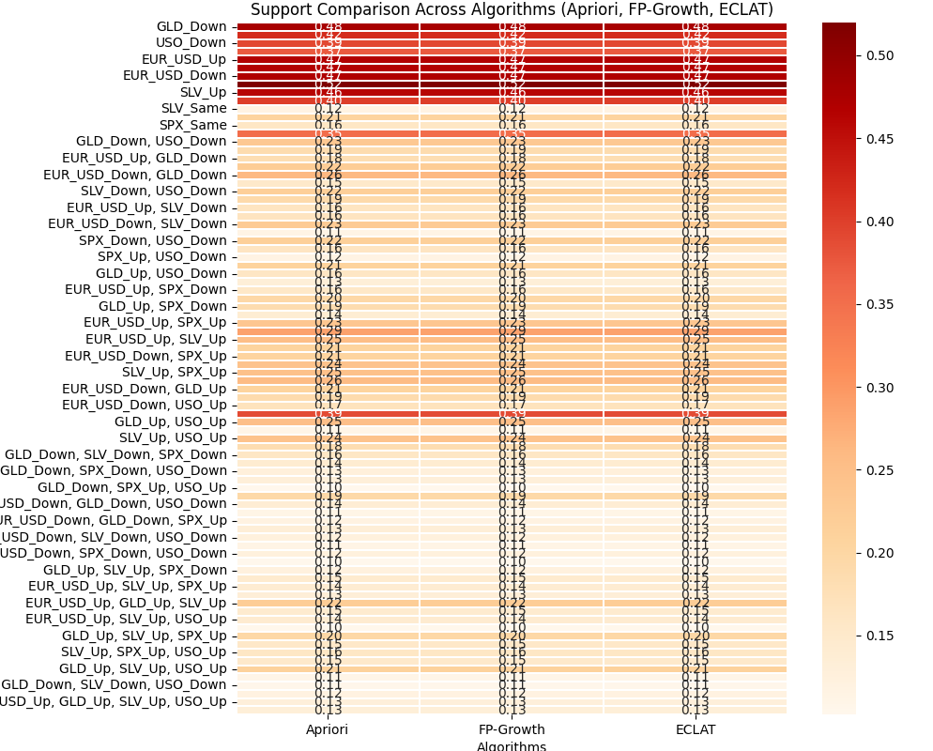
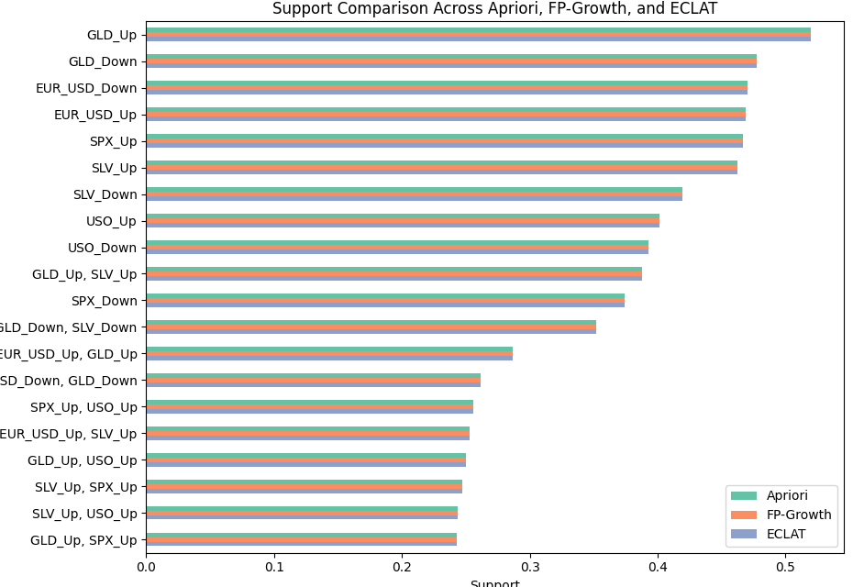
Results
Focus on Stability:
SPX_Same (15.9% support): Market stability is limited; rely more on trend-based equity strategies.
GLD_Up (51.9% support): Gold rises frequently and serves as a strong volatility hedge.
Leverage Multi-Item Associations:
GLD_Up, SLV_Up, USO_Up (21.1% support): Favor gold, silver, and oil during synchronized commodity uptrends.
SPX_Up, USO_Up (25.6% support): Bullish environment for energy-sensitive equities.
Diversify Assets:
Combine SPX_Up (46.7%) with GLD_Up (51.9%) for risk-adjusted returns.
Add SLV_Up (46.2%) as a complementary metal during positive commodity cycles.
Hedge Against Risk:
Gold commonly strengthens when equities weaken; use gold exposure to buffer downturns.
Timing Strategies:
Monitor coordinated commodity movements (e.g., GLD_Up + SLV_Up + USO_Up) as signals for strong momentum and entry points.
Notes:
ECLAT consistently captures higher support for multi-item itemsets, confirming its efficiency in finding complex patterns.
Simple itemsets (GLD_Same, SLV_Up) have similar support across all algorithms, reflecting their robustness in frequency.
The top itemsets (SPX_Same, GLD_Same, SLV_Up, etc.) have consistent support values across algorithms.
ECLAT captures more frequent and larger itemsets, which may be due to its efficient handling of vertical data representation.
For itemsets involving multiple items, ECLAT identifies higher support values than Apriori and FP-Growth.

Slide 13
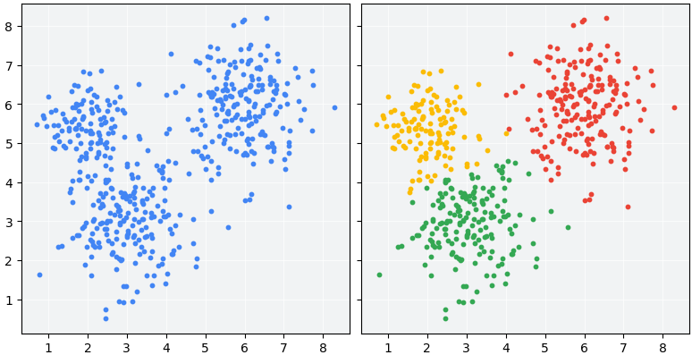
Clustering
Notes:
What is Clustering?
"Clustering is an unsupervised machine learning technique that groups similar data points to uncover hidden patterns.”
Project Goal
"Apply KMeans, DBSCAN, and Random Forest Clustering to identify meaningful clusters, evaluate their quality with metrics like the Silhouette Score and Davies-Bouldin Index, and visualize the results using PCA."

Slide 14
Methods
Method | Description | Key Parameters | Strengths | Weaknesses
KMeans | Partitions the data into k clusters by minimizing the variance within each cluster. Centers are iteratively updated to achieve the best partition. | Number of clusters (k). | Simple, fast, and works well with spherical clusters. | Sensitive to initial centroids and requires pre-specifying the number of clusters.
DBSCAN | Density-based method that groups points closely packed together while labeling low-density points as noise | eps (neighborhood radius), min_samples | Finds clusters of arbitrary shapes, robust to noise, and does not require specifying the number of clusters. | Struggles with varying density and requires careful tuning of eps and min_samples.
Random Forest Clustering | Uses a proximity matrix from Random Forest decision trees to group points based on shared paths in decision trees (unsupervised adaptation). | Number of trees in RF, distance threshold. | Handles complex structures, interpretable, and adaptable to multiple data types. | Computationally intensive, depends on synthetic labels, and indirect compared to direct clustering.
*** PCA applied to all methods.
Notes:
"Here’s a quick overview of the clustering methods we used, including their key points.”
1. KMeans
Description: Groups data into k clusters by minimizing variance.
Key Parameter: k (Number of clusters).
Strengths: Simple, fast, and effective for spherical clusters.
Weaknesses: Requires specifying k and is sensitive to initial centroids.
2. DBSCAN
Description: A density-based method that identifies dense clusters and labels outliers as noise.
Key Parameters: eps (Neighborhood radius) and min_samples.
Strengths: Finds clusters of any shape and handles noise well.
Weaknesses: Requires careful tuning of eps and min_samples.
3. Random Forest Clustering
Description: Uses a proximity matrix from decision trees to cluster data.
Key Parameters: Number of trees and distance threshold.
Strengths: Handles complex structures and is interpretable.
Weaknesses: Computationally intensive and depends on synthetic labels.
We applied PCA to all methods for easier visualization.

Slide 15
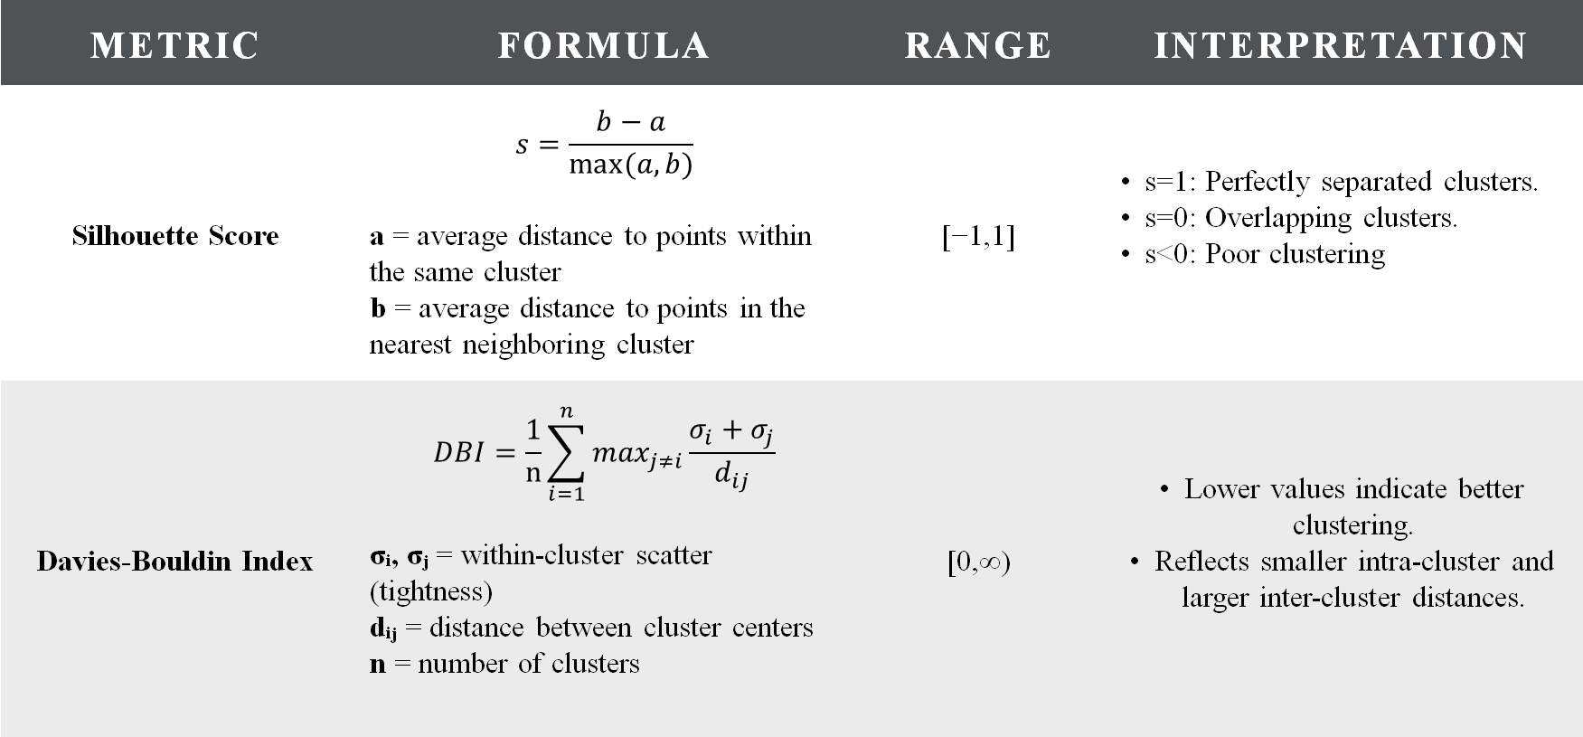
Evaluation Metrics
Metric | Formula | Range | Interpretation
Silhouette Score | $$s=\frac{b−a}{max⁡(a,b)}$$ a = average distance to points within the same cluster b = average distance to points in the nearest neighboring cluster | [−1,1] | s=1: Perfectly separated clusters. s=0: Overlapping clusters. s<0: Poor clustering
Davies-Bouldin Index | $$DBI=\frac{1}{n}\sum_{i=1}^{n}{\max_{j≠i}\frac{σ_{i}+σ_{j}}{d_{ij}}}$$ σᵢ, σⱼ = within-cluster scatter (tightness) dᵢⱼ = distance between cluster centers n = number of clusters | [0,∞) | Lower values indicate better clustering. Reflects smaller intra-cluster and larger inter-cluster distances.
Notes:
These metrics help us understand how well the data points are grouped into clusters and how distinct the clusters are from each other.

Slide 16
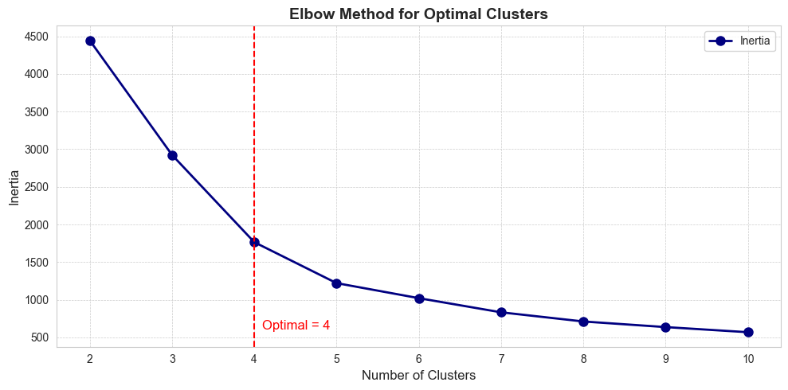
K-Means Method
Clustering Algorithm:
KMeans Clustering is used to group the data into distinct clusters.
K-Means starts by choosing K random centroids (cluster centers). Each data point is assigned to the nearest centroid, forming clusters.
The algorithm repeats assign → update → reassign until the clusters stop changing.
The final result is K compact, well-separated clusters based on distance.
Goal:
Identify the optimal number of clusters by observing where the inertia (sum of squared distances to cluster centers) decreases significantly.
Elbow Method:
Plot Inertia vs. Number of Clusters.
Notes:
Clustering Algorithm:
KMeans groups data into distinct clusters by minimizing the variance within each cluster.
Goal:
Identify the optimal number of clusters by analyzing the inertia (sum of squared distances to cluster centers).
Elbow Method:
We plotted Inertia vs. Number of Clusters.
The elbow point occurs at 4 clusters, where the inertia curve starts to flatten.
This suggests that 4 clusters is the optimal choice.
"On the right, you can see the elbow point marked with a red dashed line, clearly showing where adding more clusters stops significantly reducing inertia."

Slide 17
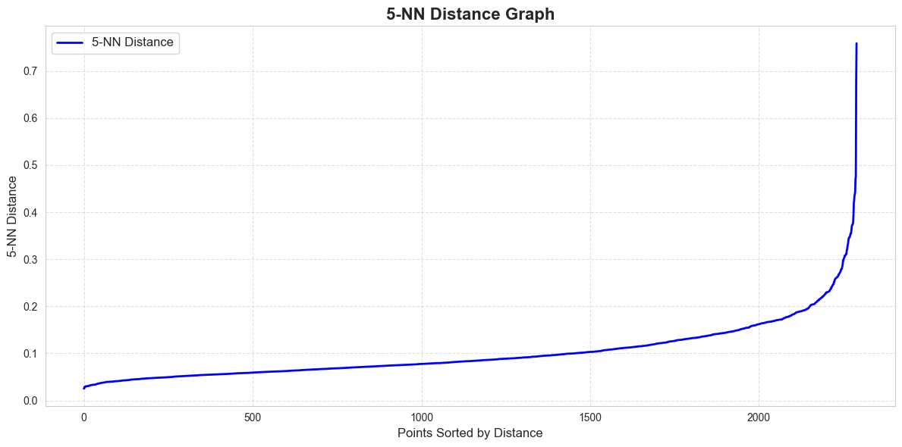
DBSCAN Method
Purpose:
Identify the optimal eps (epsilon) parameter for DBSCAN, which determines the neighborhood size for clustering.
5-NN Distance Calculation:
For each data point, calculate the distance to its 5th nearest neighbor.
Sort these distances in ascending order.
Key Observations:
The elbow point appears where the distances start to rise steeply.
In this graph, the sharp bend happens approximately around 0.2 to 0.3 on the Y-axis.
Sparse areas/noise
The elbow
Dense Clusters
Notes:
This slide explains how we used the DBSCAN method to identify clusters by determining the optimal eps (epsilon) parameter.”
Purpose:
The goal is to find the optimal eps value, which controls the neighborhood size for clustering.
5-NN Distance Calculation:
For each data point, we calculate the distance to its 5th nearest neighbor.
These distances are then sorted in ascending order.
Key Observations:
The elbow point on the 5-NN Distance Graph indicates where the distances start to rise steeply.
In our graph, the sharp bend happens between 0.2 and 0.3 on the Y-axis. This helps us determine a suitable eps value for DBSCAN.
By selecting eps around this elbow point, we ensure that DBSCAN can effectively identify clusters and distinguish noise.

Slide 18
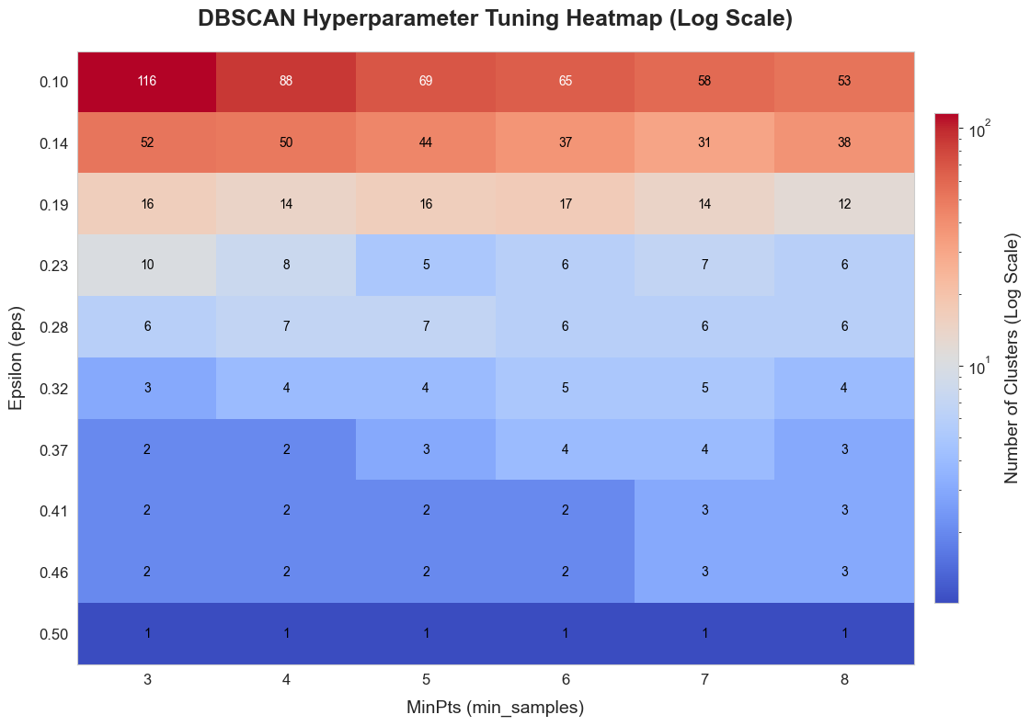
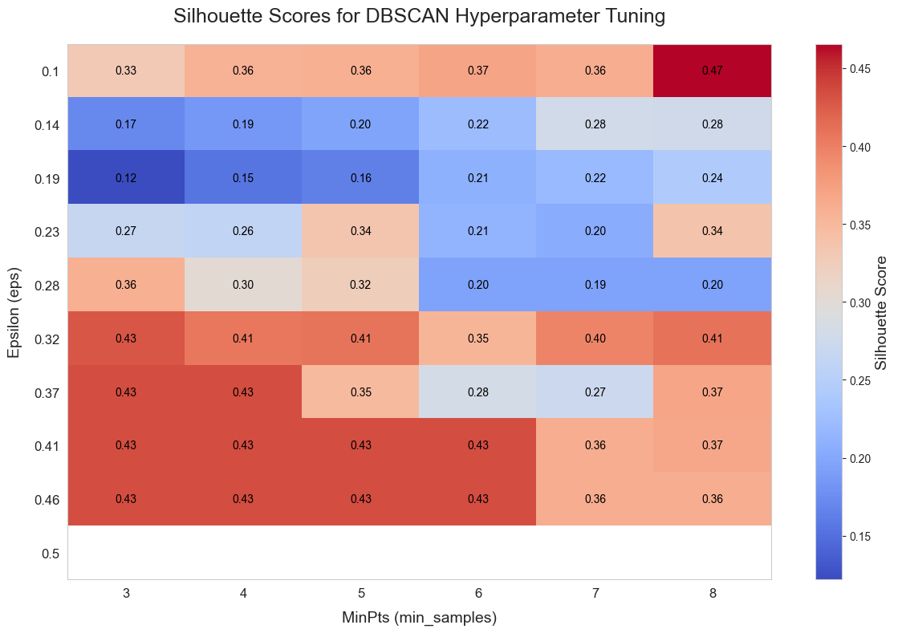
DBSCAN Method
The left heatmap shows how many clusters DBSCAN detects for each eps–min_samples combination (red = more clusters, blue = fewer clusters).
The right heatmap shows the Silhouette Scores, where higher values indicate better-defined clusters.
The best clustering quality appears with eps between 0.3–0.37 and min_samples between 4–6.
Using both heatmaps together helps identify parameters that balance cluster quantity and cluster quality.
Notes:
This slide shows the results of DBSCAN hyperparameter tuning using eps and min_samples. The heatmap on the left displays the number of clusters detected for different combinations of eps and min_samples. In this heatmap, red areas indicate more clusters, while blue areas indicate fewer clusters. We observe that smaller eps values and lower min_samples produce more clusters, while larger eps values result in fewer clusters.
The heatmap on the right shows the Silhouette Scores, which measure clustering quality. Higher scores, shown in red, indicate better-defined clusters. The best scores are achieved with eps between 0.3 and 0.37 and min_samples between 4 and 6. By combining these insights, we can select the optimal parameters for DBSCAN to balance the number of clusters and clustering quality.

Slide 19
Random Forest Clustering with Top Features
Model Details
Clustering Algorithm:
Random Forest Classifier trained with synthetic labels from Agglomerative (hierarchical) Clustering.
Number of Clusters:
4 Clusters were defined for the clustering process.
Steps Involved:
Generate Synthetic Labels using Agglomerative Clustering.
Train Random Forest to determine feature importance.
Compute Proximity Matrix from the Random Forest.
Apply Hierarchical Clustering using the Proximity Matrix.
Feature Selection
Selected Features:
The top 2 features selected based on their importance are:
norm_SLV (Normalized Silver Price)
norm_USO (Normalized Crude Oil Price)
Feature Importance:
Feature importance was derived from the Random Forest classifier trained on all features.
Notes:
In this slide, we outline the Random Forest Clustering process and the selected features.
We used a Random Forest Classifier with synthetic labels from Agglomerative Clustering to define 4 clusters. The steps involved were:
Generate synthetic labels using Agglomerative Clustering.
Train Random Forest to determine feature importance.
Compute the proximity matrix from the Random Forest.
Apply Hierarchical Clustering using this matrix.
For feature selection, the top 2 features identified were norm_SLV (Normalized Silver Price) and norm_USO (Normalized Crude Oil Price). These features were chosen based on their importance scores from the Random Forest model.
This process helped us identify key features driving the clustering results.

Slide 20
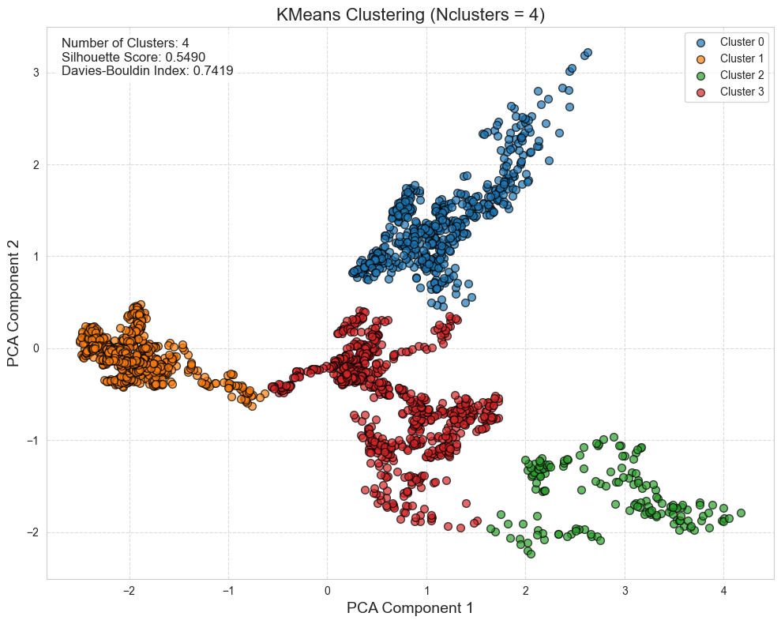
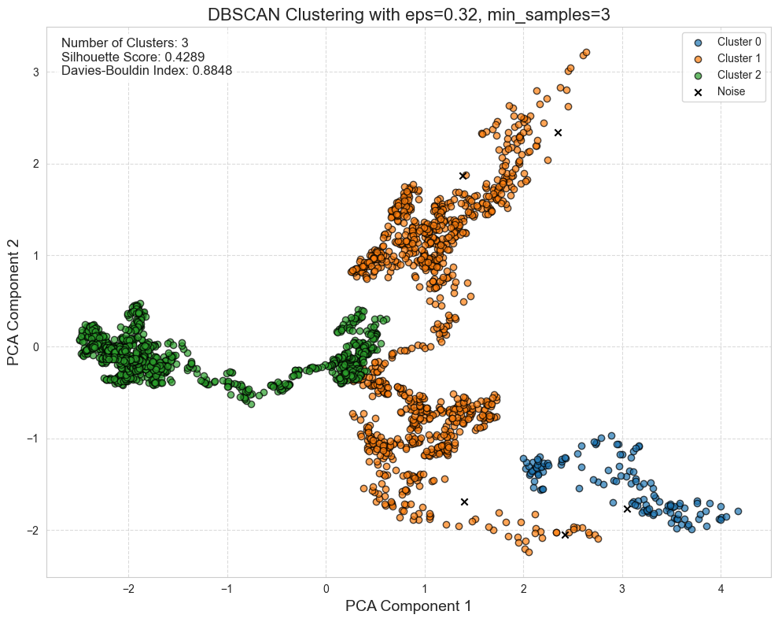
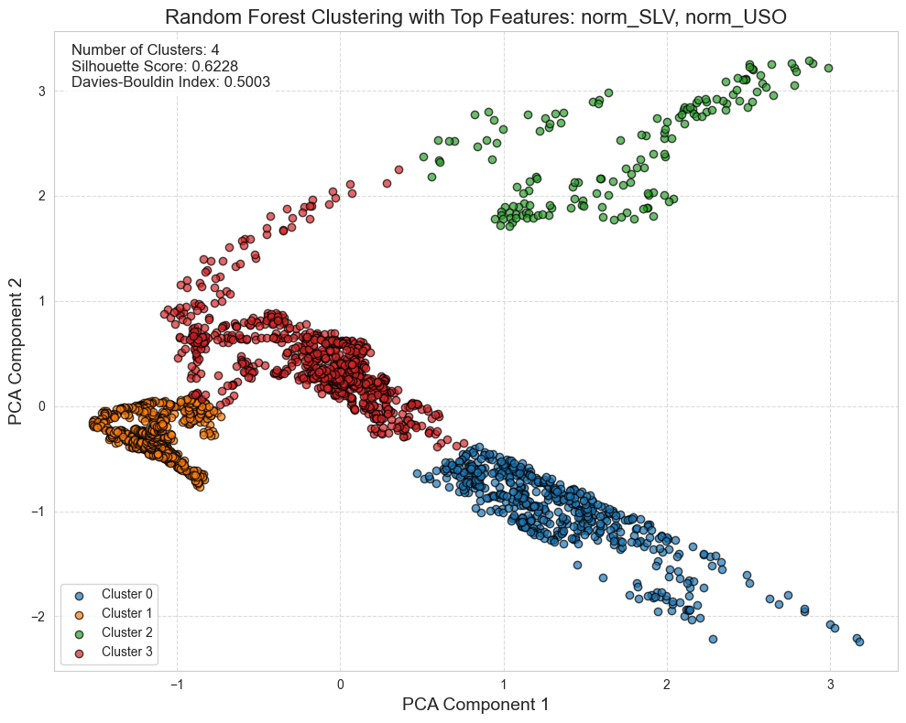
Results
Produces 4 clear clusters with good separation in PCA space.
Silhouette Score ≈ 0.55 → indicates moderately well-separated clusters.
DBI ≈ 0.74 → lower value means better clustering compactness.
Identifies 3 clusters + noise points, capturing natural density-based structure.
Silhouette Score ≈ 0.42 → clusters overlap more than K-Means.
DBI ≈ 0.88 → less compact clusters compared to K-Means and Random Forest clustering.
Produces 4 well-defined clusters.
Silhouette Score ≈ 0.62 → highest cluster quality among the three methods.
DBI ≈ 0.50 → best compactness and separation.
Notes:
This slide presents the clustering results for the three methods we used: KMeans, DBSCAN, and Random Forest Clustering. Each plot shows the clusters visualized using PCA components.
showing results and talking about results for others. Based on the results, Random Forest Clustering achieved the highest Silhouette Score and the lowest Davies-Bouldin Index, indicating the best clustering performance. Therefore, Random Forest Clustering is the most suitable method for this dataset, as it captures complex relationships and produces well-defined clusters.

Slide 21
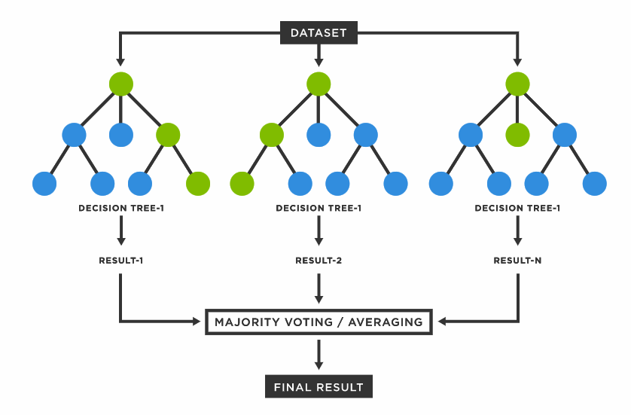
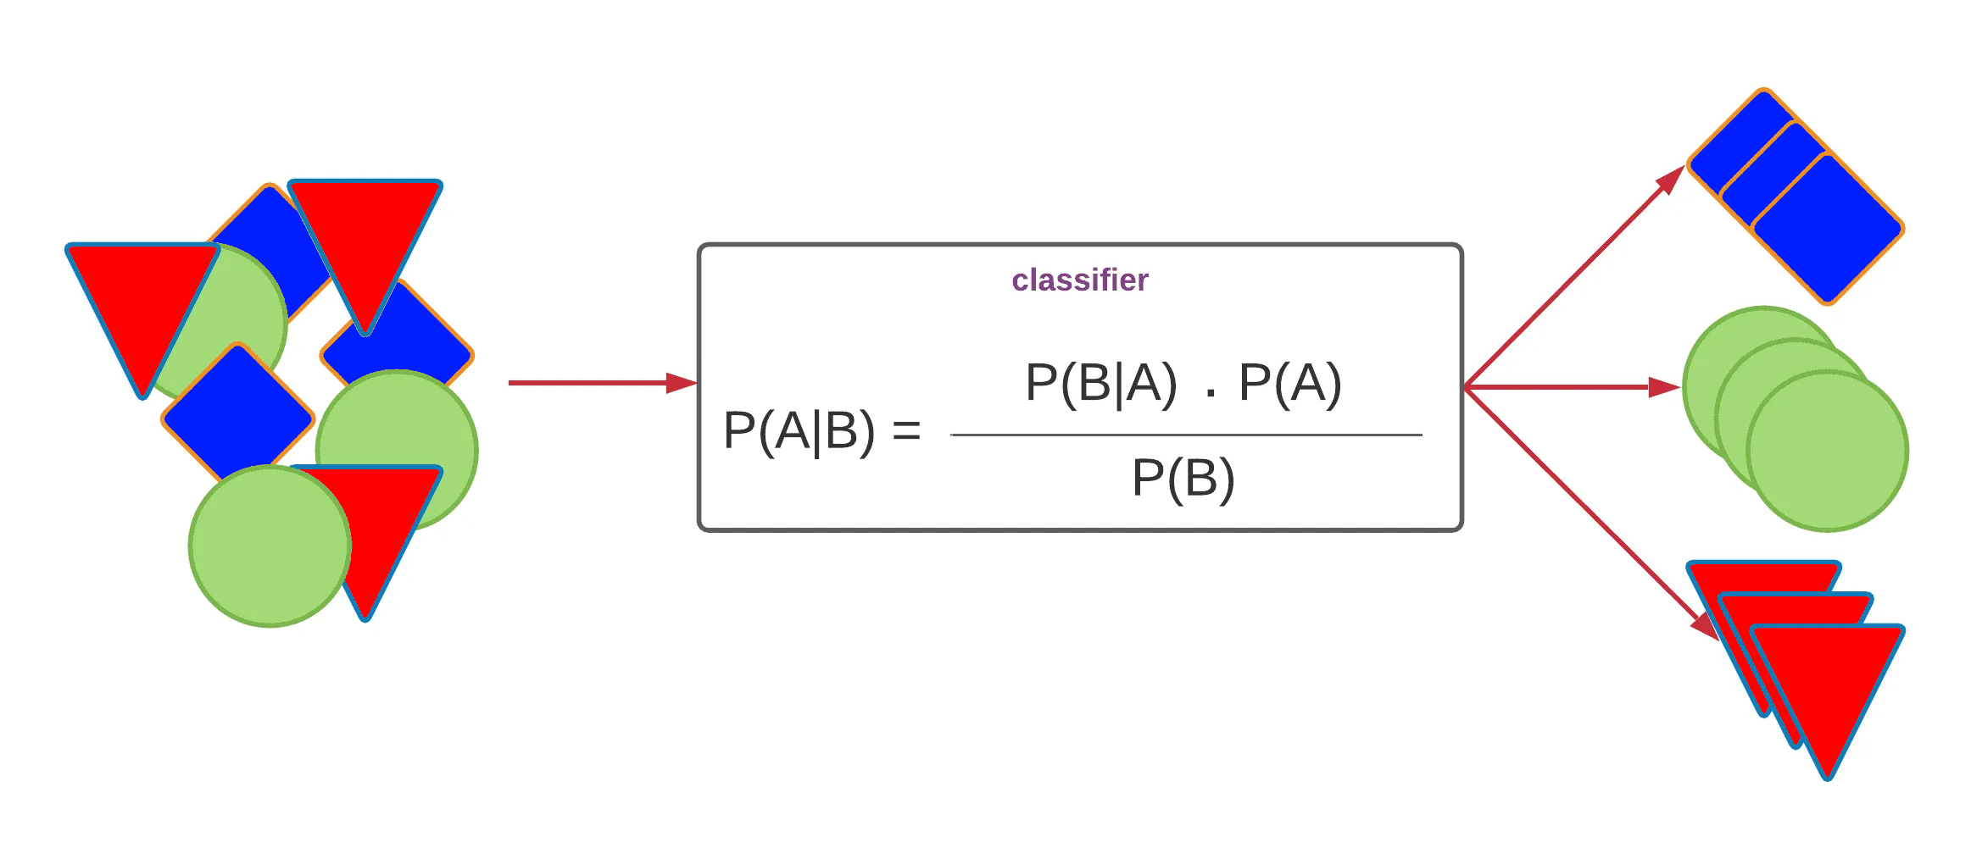
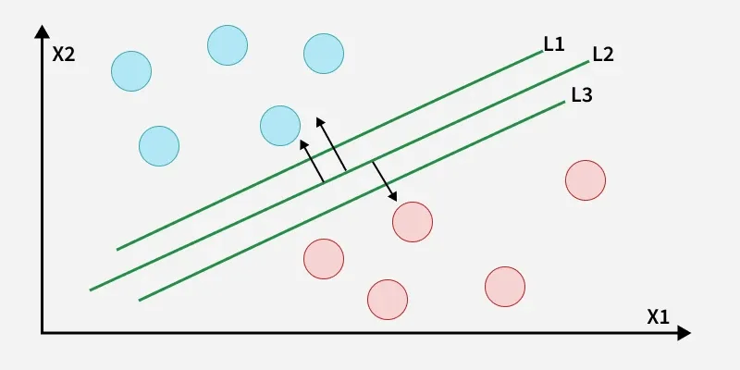
Classification

Slide 22
Methods
Method | Description | Key Parameters | Strengths | Weaknesses
Random Forest | An ensemble method that builds multiple decision trees and combines their outputs to improve accuracy and reduce overfitting. | Number of trees Max tree depth | Robust to overfitting due to averaging/voting mechanism. | Computationally intensive with a large dataset or many trees.
SVM | A supervised learning method that finds the optimal hyperplane to separate data points into different classes, maximizing the margin between classes. | Kernel type Regularization - Parameter | Effective in high-dimensional spaces. | Struggles with overlapping classes or noisy data.
Naïve Bayes Classifier | A probabilistic classifier based on Bayes' Theorem, assuming independence between features. | Distribution Type | Simple and fast to implement. | Less effective with complex feature interactions.

Slide 23
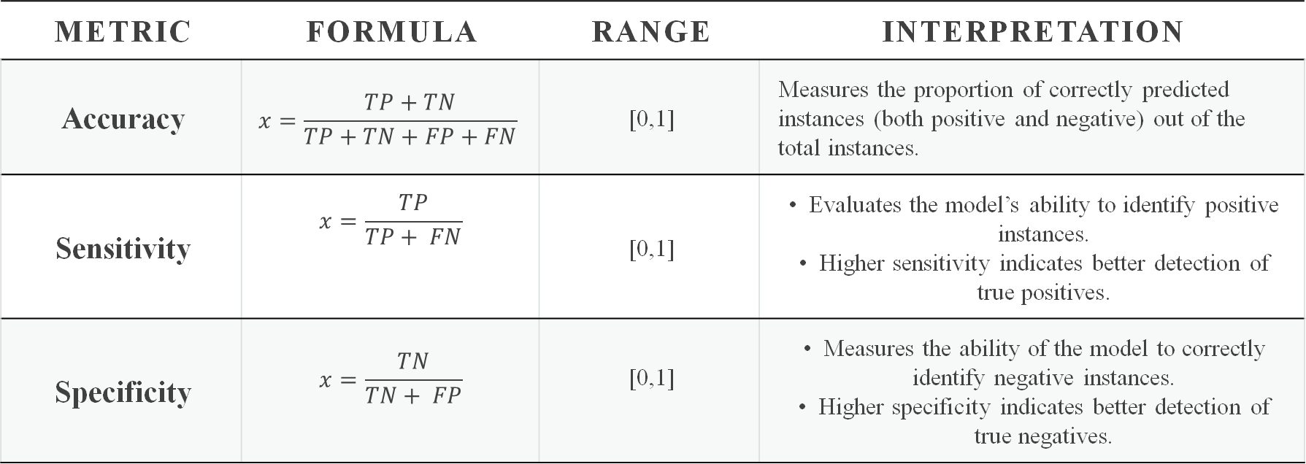
Evaluation
Metric | Formula | Range | Interpretation
Accuracy | $$x=\frac{TP+TN}{TP+TN+FP+FN}\text{​}$$ | [0,1] | Measures the proportion of correctly predicted instances (both positive and negative) out of the total instances.
Sensitivity | $$x=\frac{TP}{TP+ FN}\text{​}$$ | [0,1] | Evaluates the model’s ability to identify positive instances. Higher sensitivity indicates better detection of true positives.
Specificity | $$x=\frac{TN}{TN+ FP}\text{​}$$ | [0,1] | Measures the ability of the model to correctly identify negative instances. Higher specificity indicates better detection of true negatives.

Slide 24
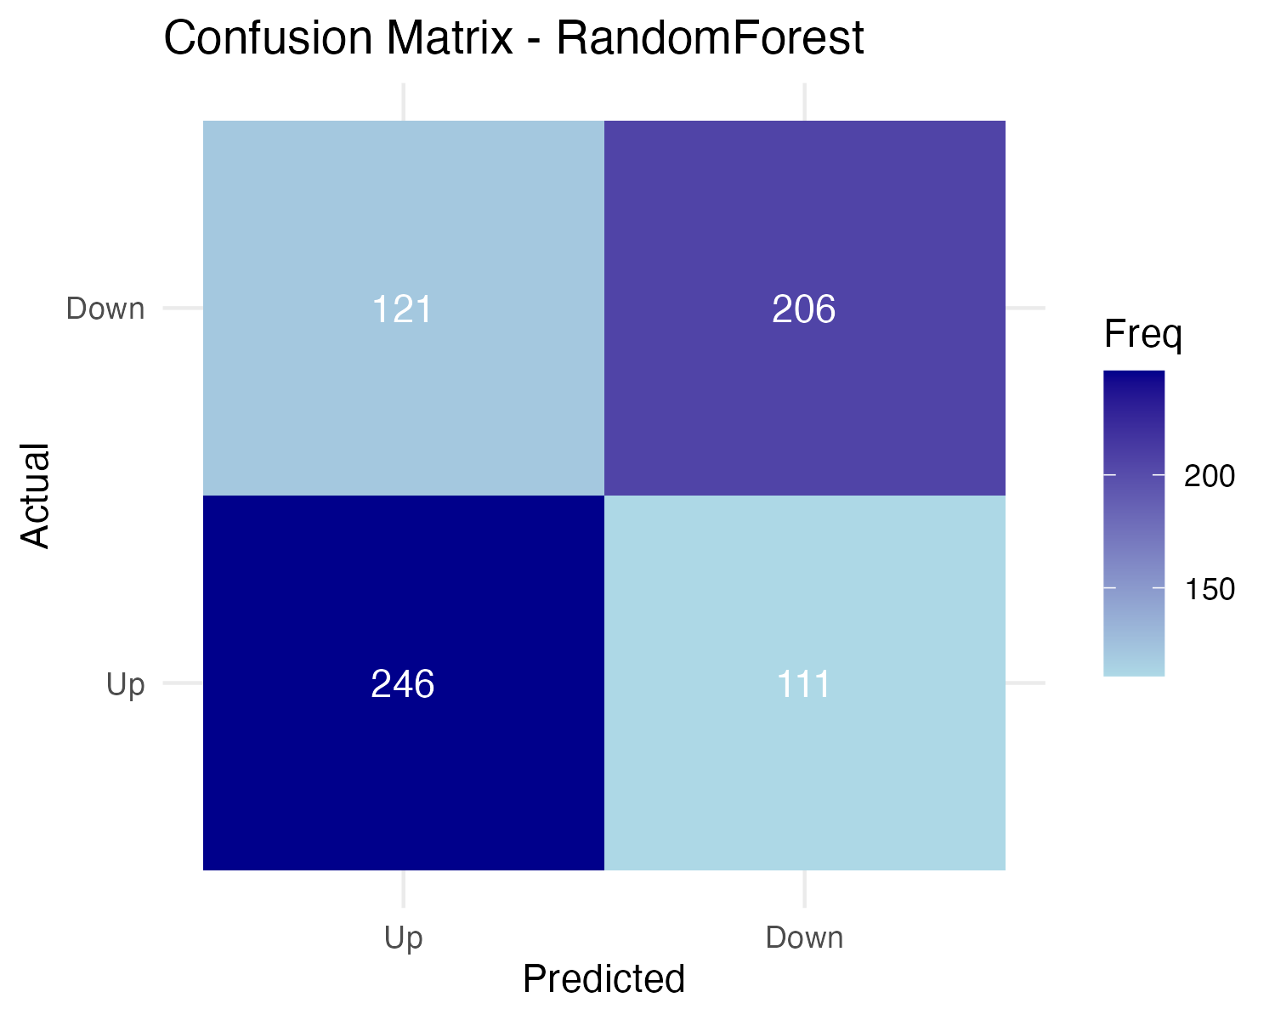
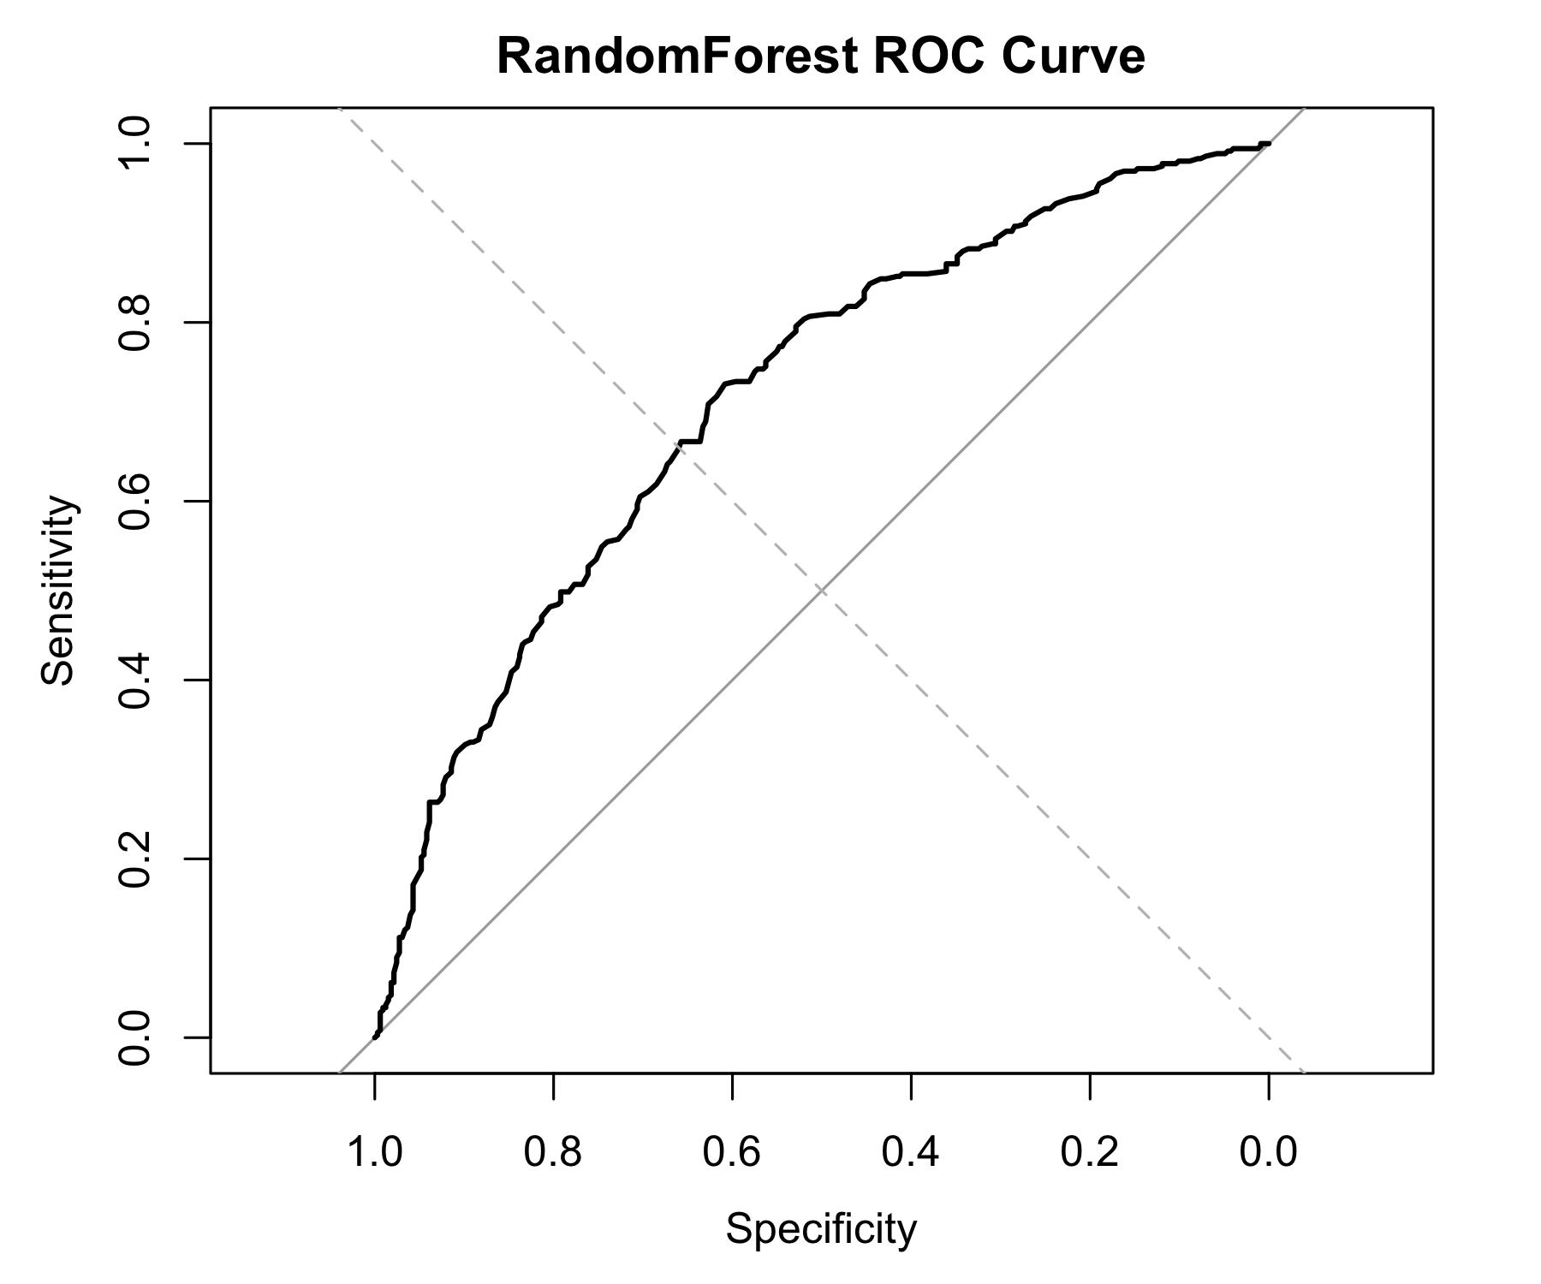
Random Forest
Correct predictions: • 206 True Negatives (Down → Down) • 246 True Positives (Up → Up)
Incorrect predictions: • 121 False Positives (Down → Up) • 111 False Negatives (Up → Down)
This high count of false positives and false negatives suggests the model struggles to separate the two classes, meaning the features may not strongly differentiate Up vs. Down movements or the model may require further tuning.
Performance Evaluation:
The ROC curve rises well above the diagonal baseline, showing the Random Forest model clearly outperforms random guessing in distinguishing Up vs. Down movements.
The curve’s shape indicates good sensitivity and specificity, meaning the model ranks positive (Up) cases higher than negative ones across thresholds.
Overall curvature suggests strong discriminative power, reflected in a high AUC value and consistent separation between the two classes.

Slide 25
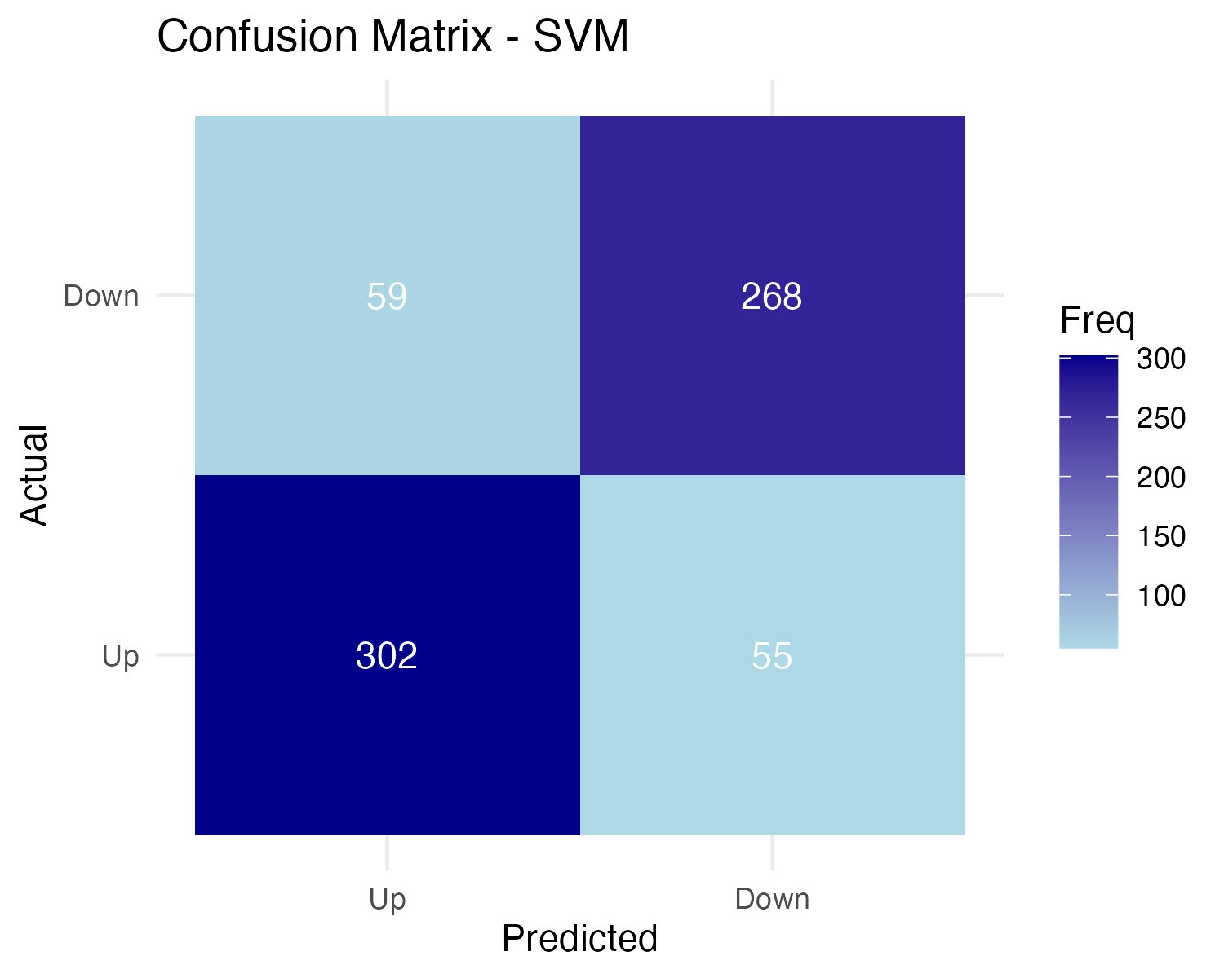
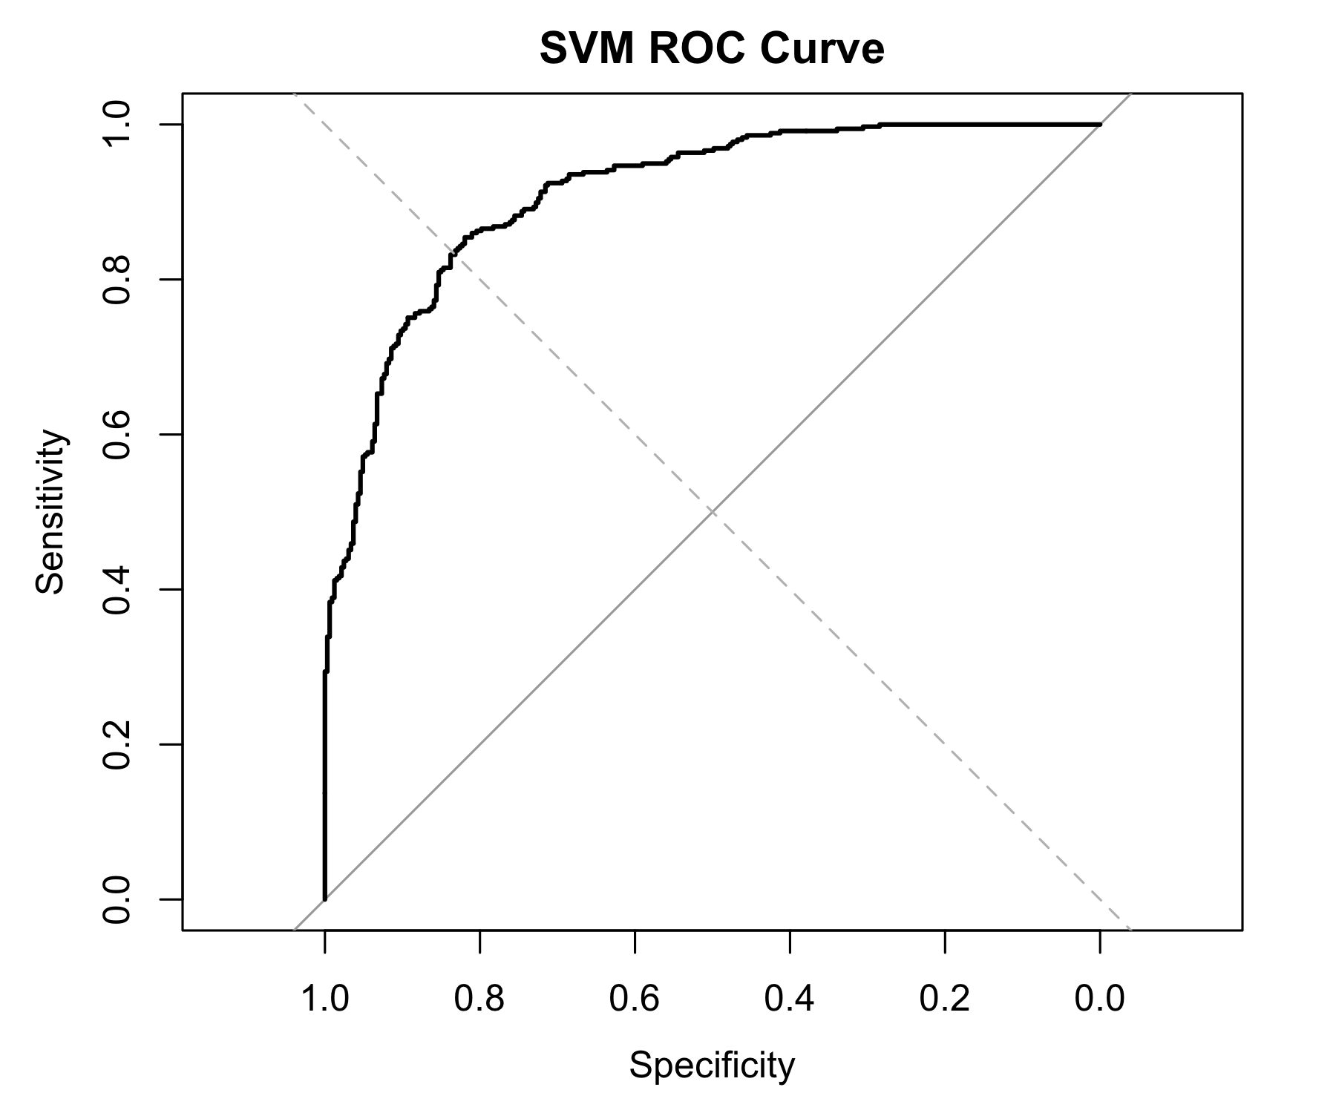
Support Vector Machines (SVM)
Correct predictions • 268 True Negatives (Actual Down → Predicted Down) • 302 True Positives (Actual Up → Predicted Up)
Incorrect predictions → • 59 False Positives (Down → Up) • 55 False Negatives (Up → Down)
Overall → The SVM model shows strong performance in both classes, with relatively few misclassifications compared to Random Forest, indicating better separation between Up and Down patterns.
ROC Curve – SVM
The ROC curve rises sharply toward the top-left, showing that SVM has high sensitivity across a wide range of specificity values.
Its shape and high AUC indicate strong discriminative power, meaning the model reliably ranks Up vs. Down cases.
The curve staying far above the diagonal baseline demonstrates that the SVM model significantly outperforms random guessing.

Slide 26
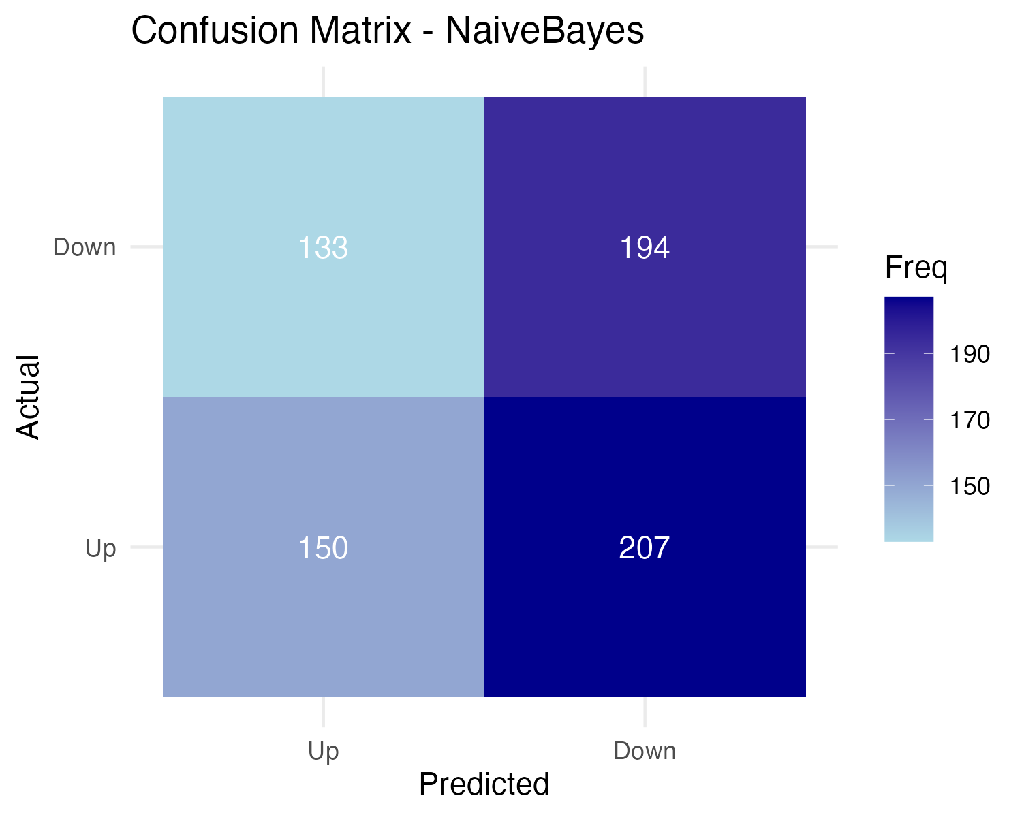
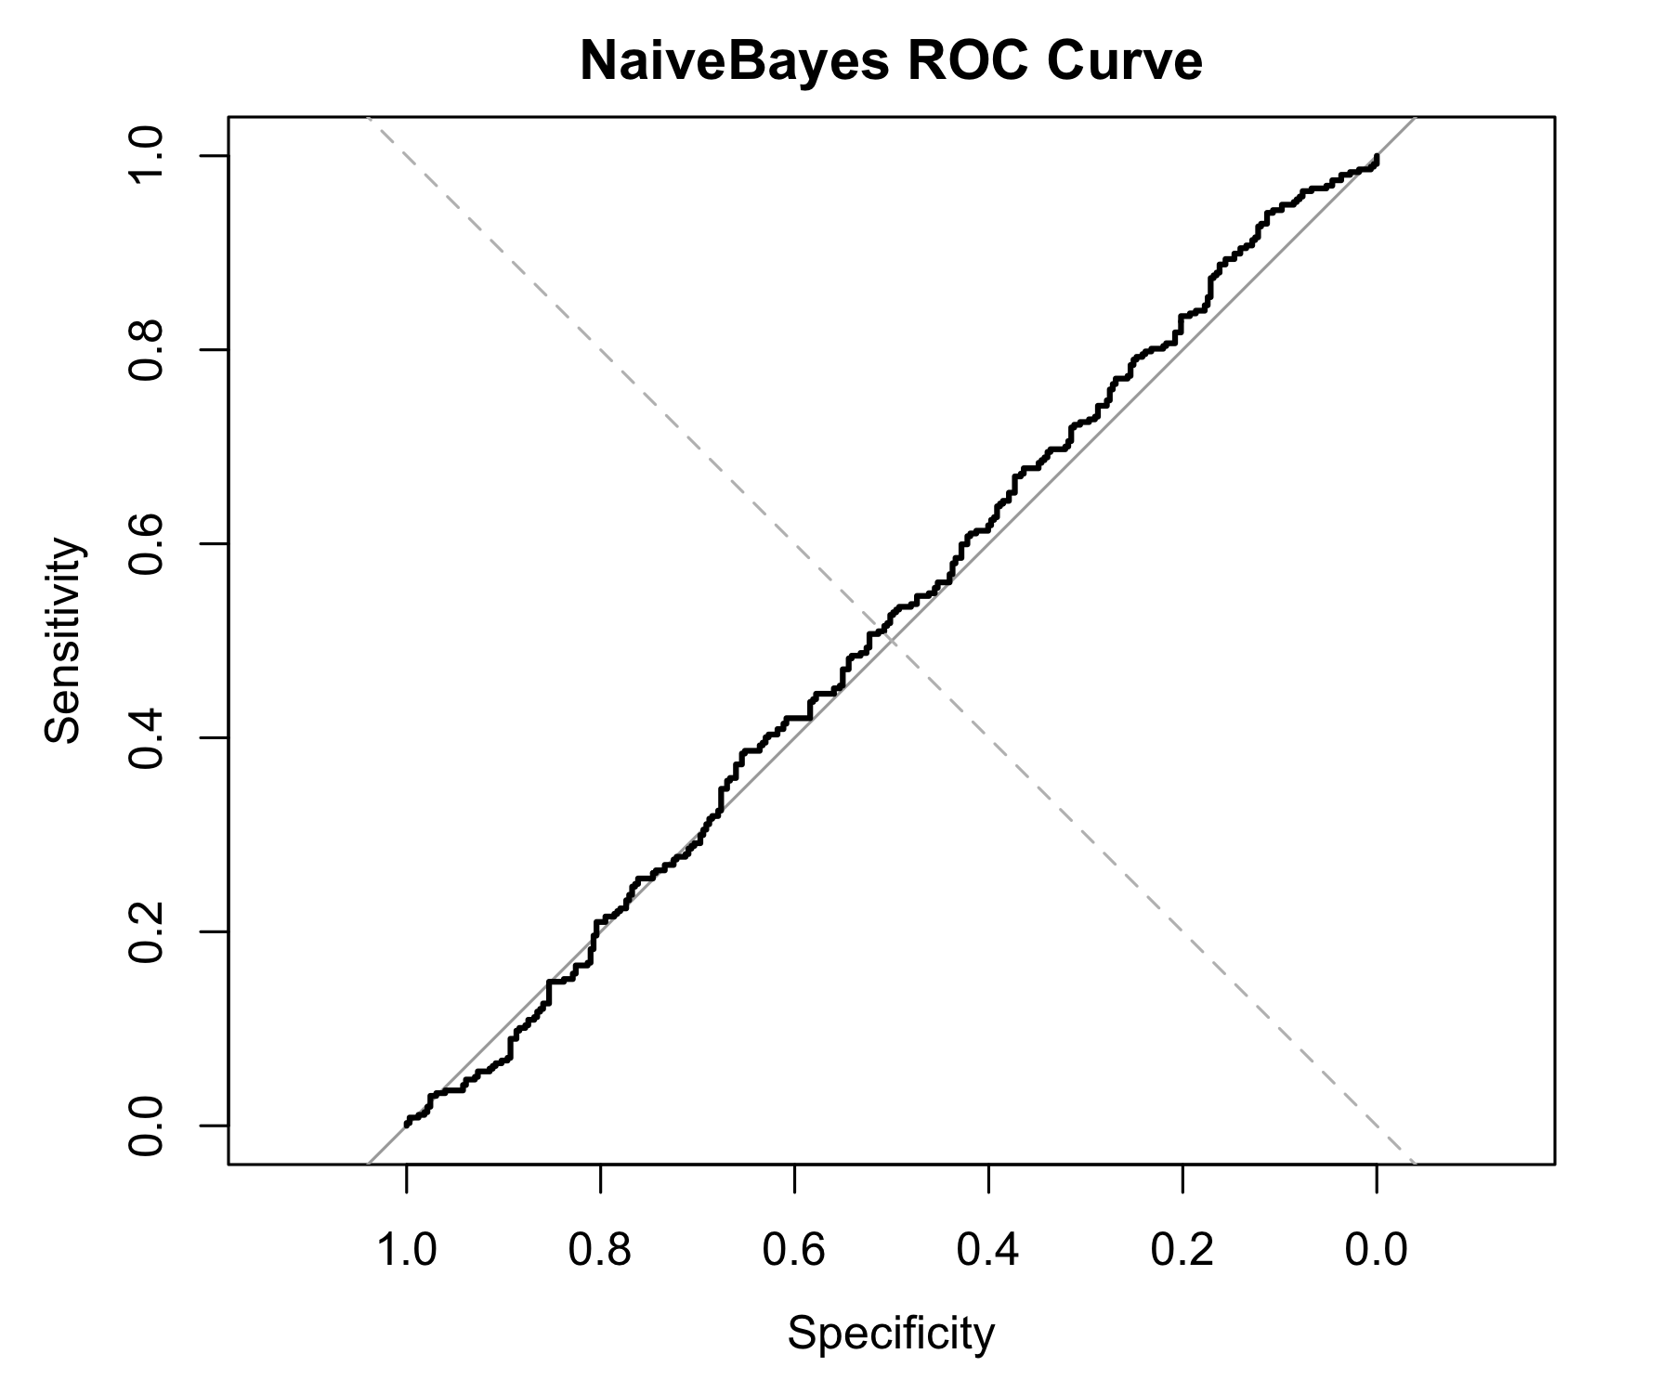
Naïve Bayes Classifier
Correct predictions → • 133 True Negatives (Actual Down → Predicted Down) • 207 True Positives (Actual Up → Predicted Up)
Incorrect predictions → • 194 False Positives (Down → Up) • 150 False Negatives (Up → Down)
Overall → The model misclassifies a large portion of both classes, suggesting Naive Bayes cannot capture the underlying feature relationships needed to distinguish Up vs. Down movements.
ROC Curve – Naive Bayes
The ROC curve lies very close to the diagonal line, indicating weak discriminative ability.
Sensitivity increases only slightly as specificity decreases, meaning the model struggles to separate the two classes based on predicted probabilities.
The resulting low AUC reflects a classifier that performs only slightly better than random guessing.

Slide 27
Results
SVM is the strongest performer, achieving the highest accuracy (0.83), sensitivity (0.84), specificity (0.82), and AUC (0.91), indicating excellent ability to distinguish Up vs. Down movements.
Random Forest shows moderate performance, with reasonable sensitivity (0.69) and AUC (0.71), but lower specificity and higher error rate compared to SVM.
Naive Bayes performs poorly, with accuracy near chance level (0.50) and low AUC (0.51), suggesting the model cannot capture the nonlinear relationships in the dataset.
Overall, nonlinear models (SVM, RF) outperform linear-probabilistic methods (NB), indicating that gold price movement is influenced by complex feature interactions rather than simple conditional independence.
Model | Accuracy | Error rate | Sensitivity | Specificity | AUC
RandomForest | 0.66 | 0.34 | 0.69 | 0.63 | 0.71
SVM | 0.83 | 0.16 | 0.84 | 0.82 | 0.91
NaiveBayes | 0.50 | 0.49 | 0.42 | 0.59 | 0.51

Slide 28
Results
Gold price movements are influenced by multiple interconnected market factors, with Silver (SLV), Oil (USO), the S&P 500 (SPX), and the EUR/USD exchange rate showing the strongest relationships in both correlation and association rule mining.
Association analysis (Apriori, FP-Growth, ECLAT) consistently reveals that GLD, SLV, and USO move closely together, confirming strong co-movement patterns across commodity markets.
Clustering results show that:
K-Means forms moderately well-separated groups,
DBSCAN identifies natural density-based structures but is sensitive to parameter choices,
Random Forest–based clustering achieves the best cluster quality, confirming that SLV and USO are the most informative features.
Classification results demonstrate that:
SVM is the strongest model, delivering the highest accuracy, sensitivity, specificity, and AUC (0.91).
Random Forest performs moderately well, capturing nonlinear patterns with an AUC of 0.71.
Naive Bayes underperforms, indicating that gold movement cannot be captured by simple conditional independence assumptions.
Overall, gold price prediction benefits most from nonlinear models and feature-driven approaches, reflecting the complex, intertwined nature of global financial markets.

Slide 29

Thank you for your time and attention!

